Slide 1
AS91883(1.7) & AS91884(1.8) Documentation
Joshua Bracefield

Slide 2
Māori Quiz Project
Link to GitHub Repository: [GitHub Repository]
Links to Trello board / project management tools: [Māori quiz project]
Link to final version of your program: [Full Game]
Ensure you have made these links ‘public’ so that they are open to anyone, including the marker. The link to your program is the final outcome of this whole project – your finished program.

Slide 3
Describe relevant Implications:
Additional rows can be added by clicking in the last cell and then using the Tab key
Relevant implication | Describe the implication and give an example
Functionality | Functionality is about making sure your program works the way you have designed it, and that it functions the way you made it.
Usability | Usability is about making sure that the program is easy to use, and that the program can do what it needs to do.
Accessibility | Accessibility is about making sure that all of the users that will use your program are able to use it properly.
Aesthetics | Aesthetics is about what and how your program looks. If a program looks good, it will function with the intent that you have. If it doesn't look formatted, you might find several errors in the code.
Notes:
Additional rows can be added by clicking in the last cell and then using the Tab key

Slide 4
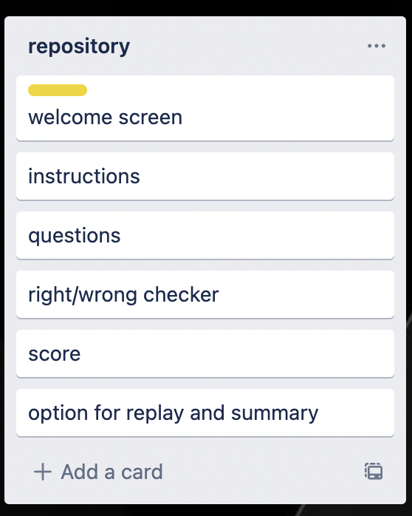
Decomposition:
Notes:
Paste screenshots of your initial Trello board / task decomposition on this slide. If you have a long list, you might need to break it up into several slides.

Slide 5
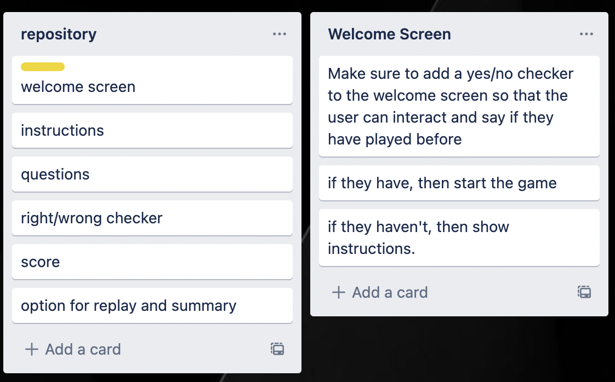
Welcome Screen

Slide 6
Welcome Screen - Test Plan
Additional rows can be added by clicking in the last cell and then using the Tab key
Test Cases - input | Expected output
Yes/yes | Program continues
Y/n | Program continues
No/no | Show instructions
N/n | Show instructions
Anything else | Error
Notes:
Additional rows can be added by clicking in the last cell and then using the Tab key

Slide 7
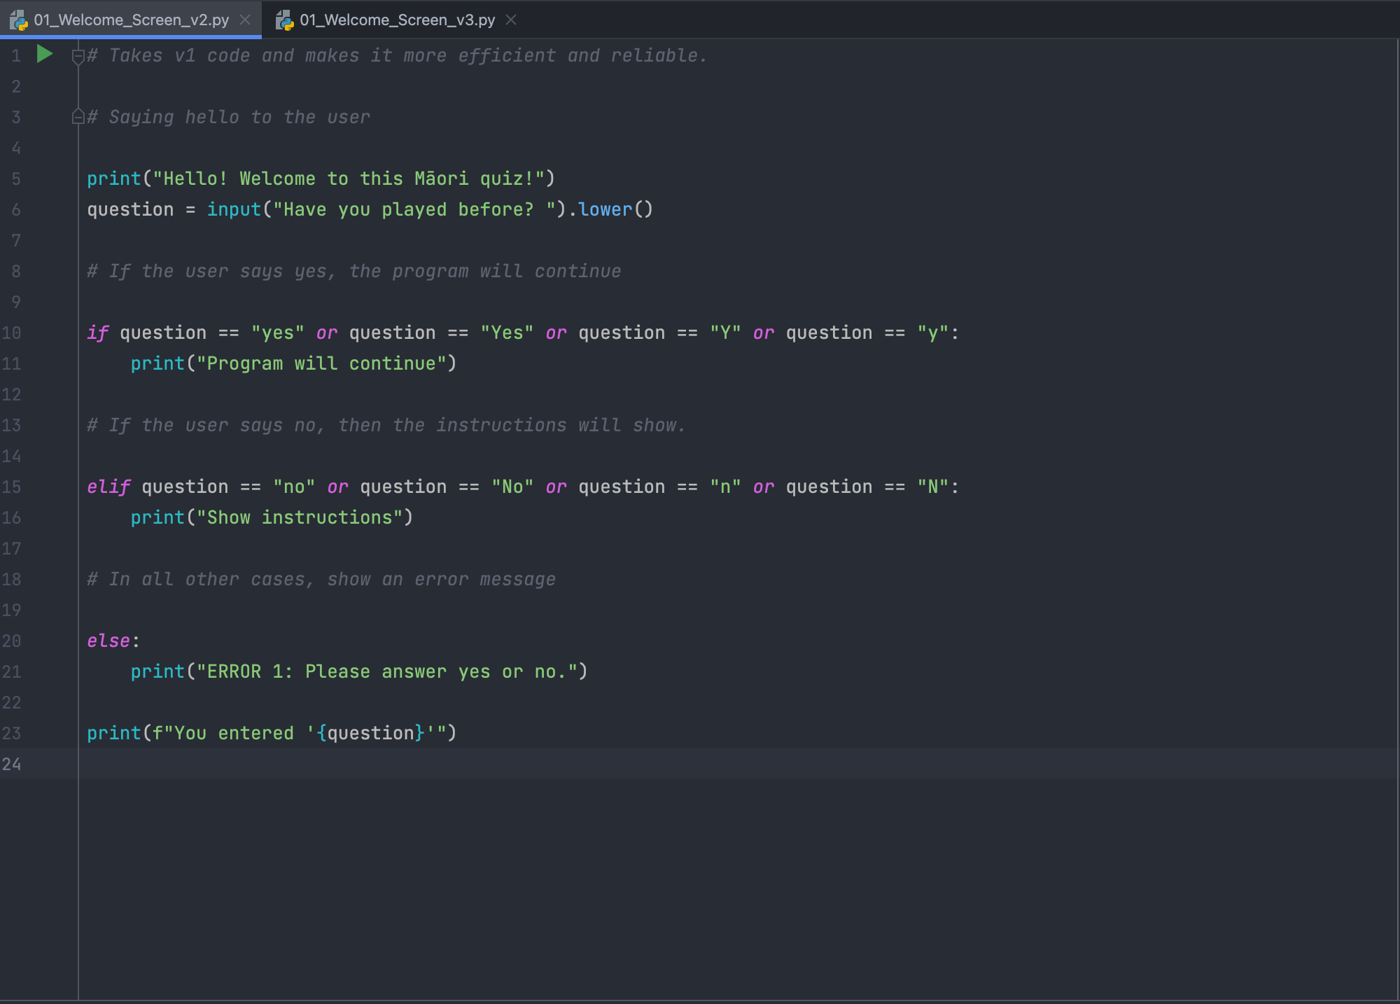
Welcome Screen: Trialling
I had 3 versions to choose from, and I chose Version 2 for my project as it is an effective, yet efficient and reliable system. I decided that version 2 would be the base for the Welcome Screen Function as well.

Slide 8
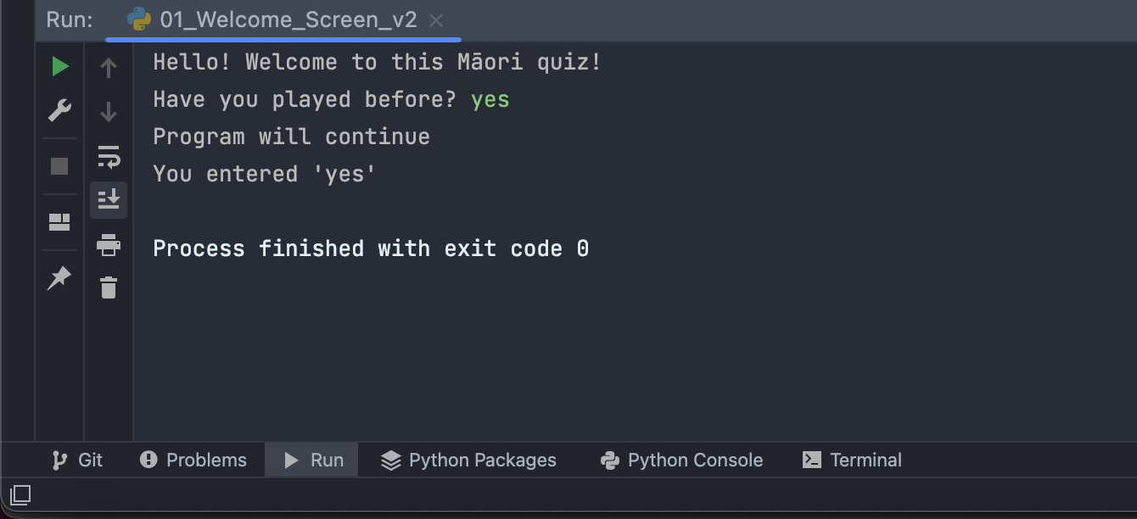
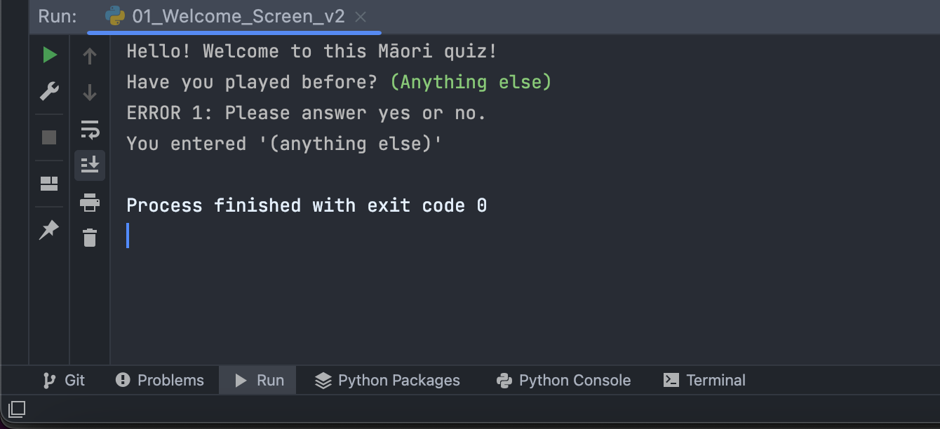
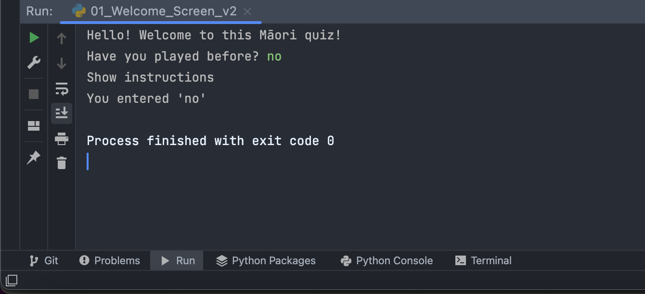
Welcome Screen: Testing
Notes:
You must show the results of testing. For each component, include a screenshot proving it works. You can also include notes about each test.

Slide 9
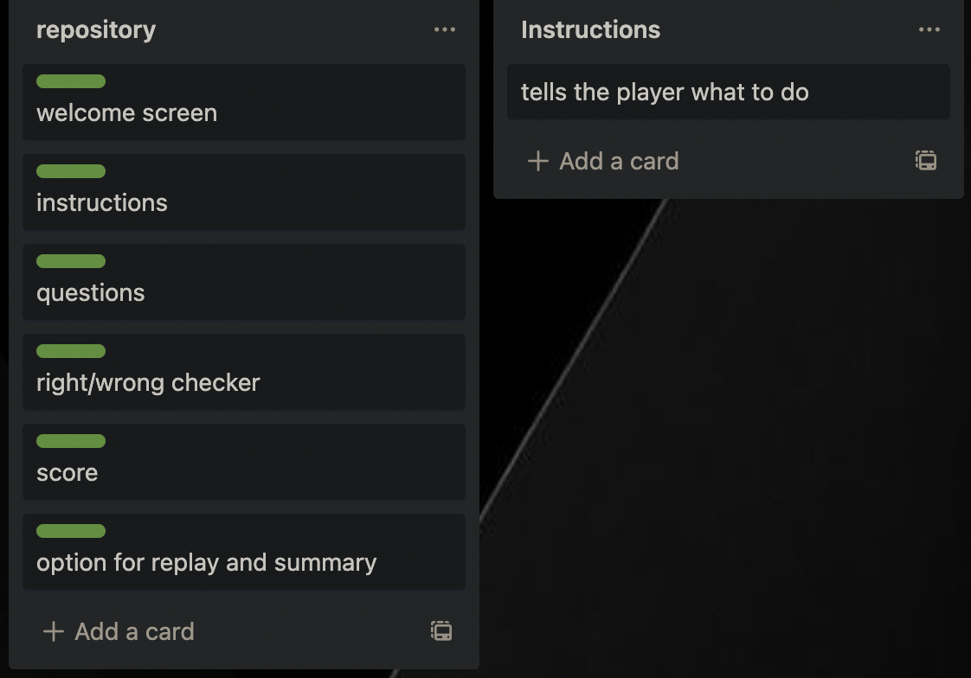
Decomposition:
Notes:
Paste screenshots of your initial Trello board / task decomposition on this slide. If you have a long list, you might need to break it up into several slides.

Slide 10
Instructions - Test Plan
Test Cases - input | Expected output
Yes/yes | Program continues and player starts game
Y/n | Program continues and player starts game
No/no | Show instructions, and then ask to start game
N/n | Show instructions, and then ask to start game
Anything else | Error, and asks it again
Notes:
Additional rows can be added by clicking in the last cell and then using the Tab key

Slide 11
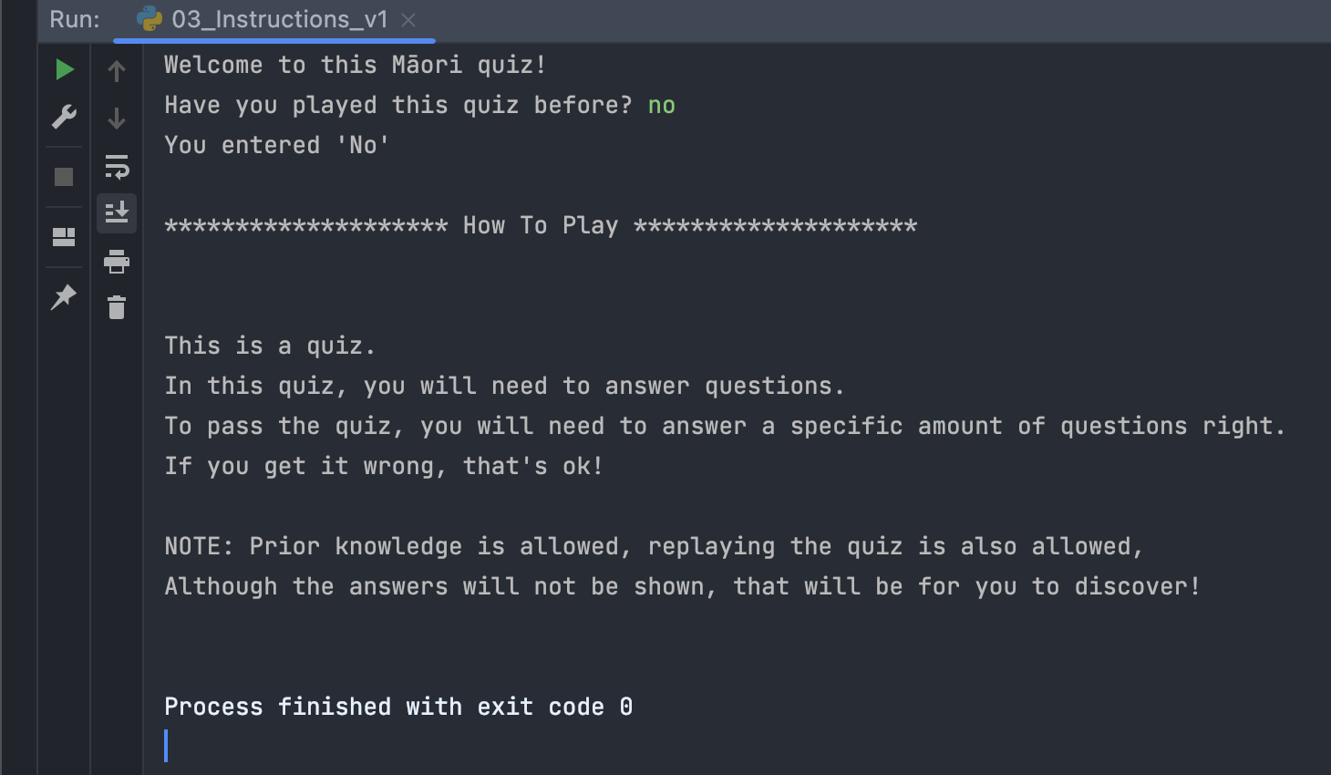
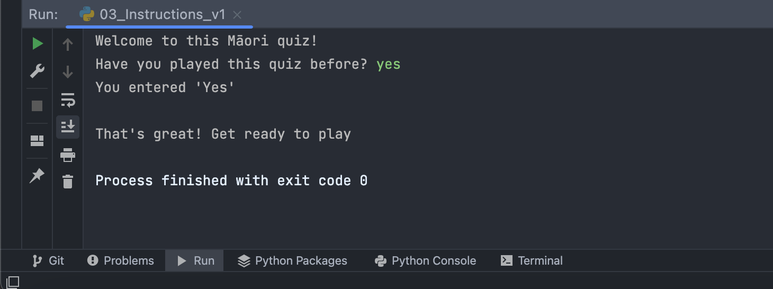
Instructions: Testing
Notes:
You must show the results of testing. For each component, include a screenshot proving it works. You can also include notes about each test.

Slide 12
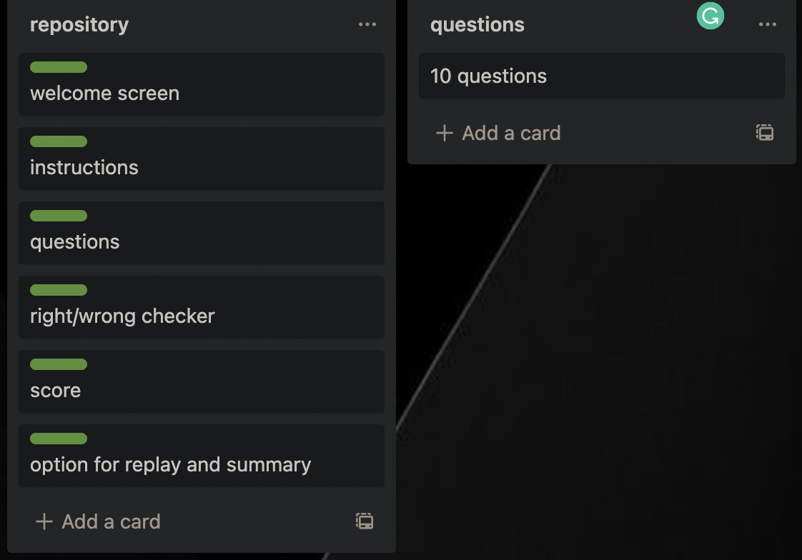
Decomposition:
Notes:
Paste screenshots of your initial Trello board / task decomposition on this slide. If you have a long list, you might need to break it up into several slides.

Slide 13
Questions- Test Plan
Test Cases - input | Expected output
Any Māori number between 1 and 10 (spelt correctly) | tells the user they are correct
Anything else | tells the user they are incorrect
Notes:
Additional rows can be added by clicking in the last cell and then using the Tab key

Slide 14
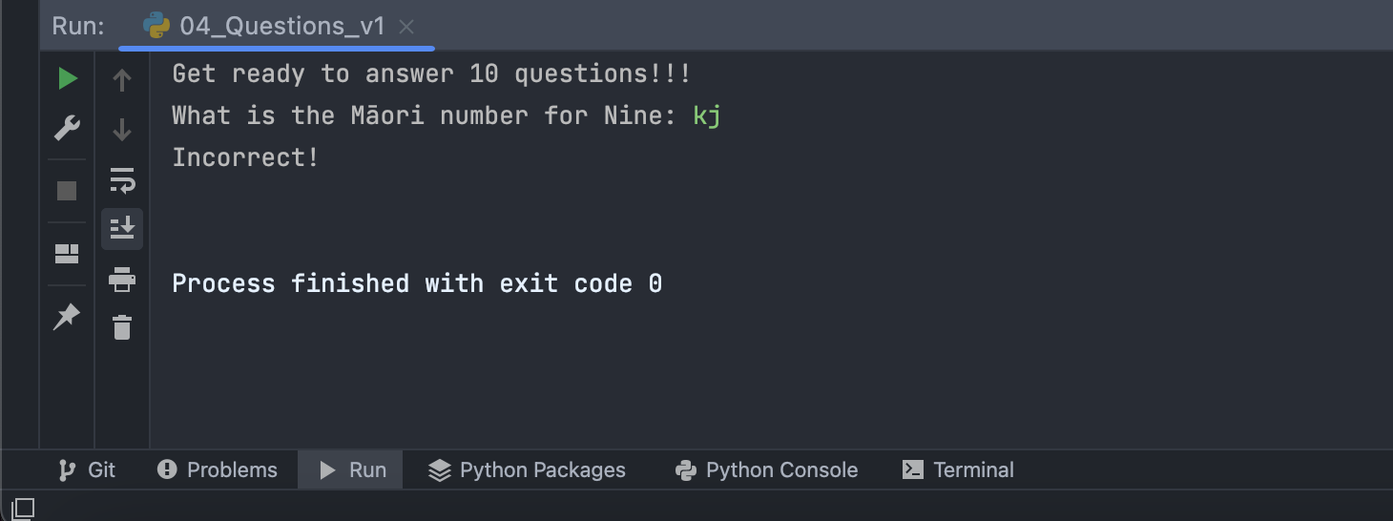
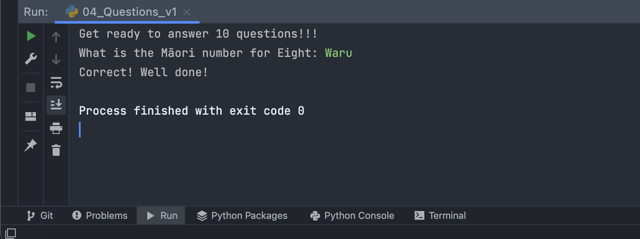
Questions: Testing
Notes:
You must show the results of testing. For each component, include a screenshot proving it works. You can also include notes about each test.

Slide 15
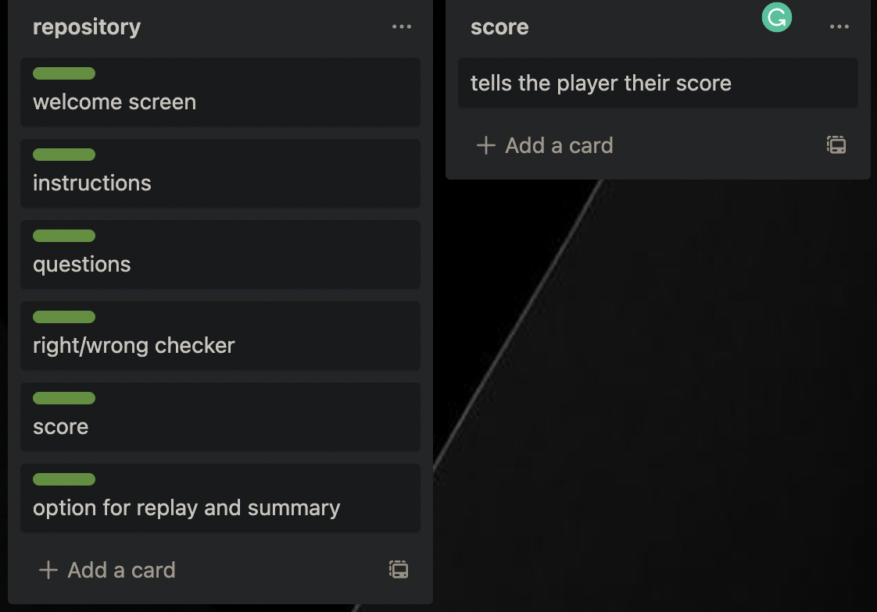
Decomposition:
Notes:
Paste screenshots of your initial Trello board / task decomposition on this slide. If you have a long list, you might need to break it up into several slides.

Slide 16
There is no test plan for the score, as there is no input from the user. But there is proof that it works (On the next slide)
Notes:
Additional rows can be added by clicking in the last cell and then using the Tab key

Slide 17
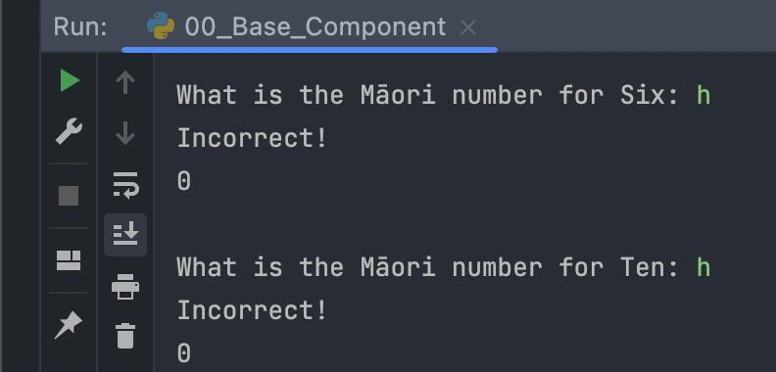
Score: Testing
The number ‘0’ is actually the score, believe it or not.
Notes:
You must show the results of testing. For each component, include a screenshot proving it works. You can also include notes about each test.

Slide 18
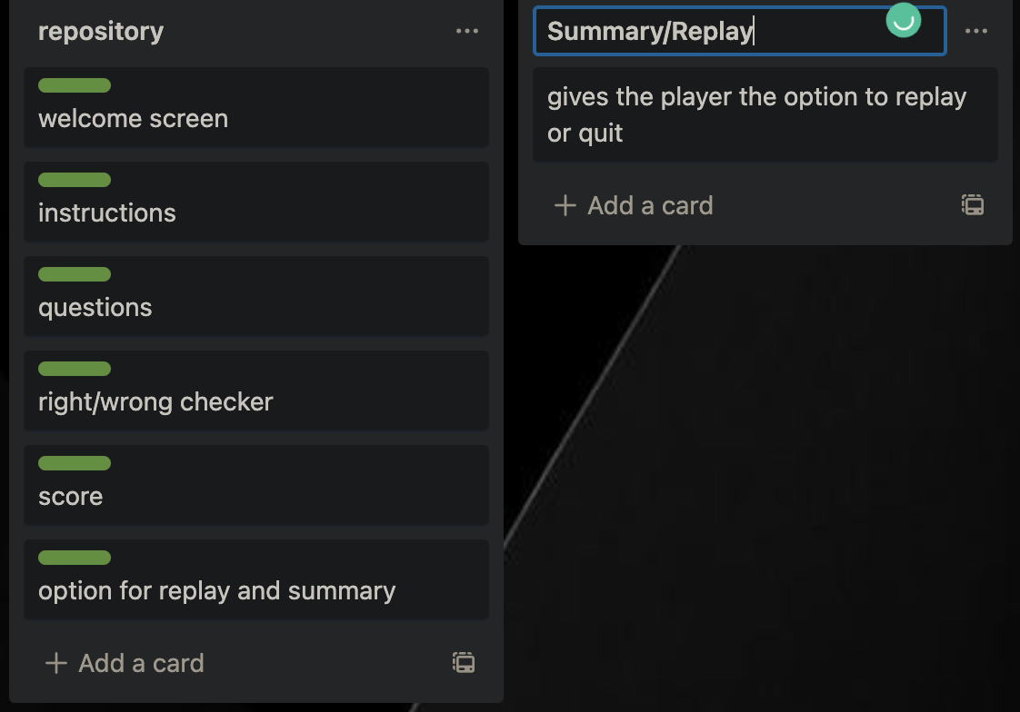
Decomposition:
Notes:
Paste screenshots of your initial Trello board / task decomposition on this slide. If you have a long list, you might need to break it up into several slides.

Slide 19
There is no test plan for the summary/replay, as there is no input from the user. But there is proof that it works (On the next slide)
Notes:
Additional rows can be added by clicking in the last cell and then using the Tab key

Slide 20
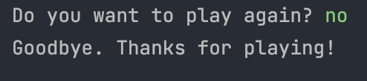
Summary/Replay: Testing
Gives option for summary/replay
Notes:
You must show the results of testing. For each component, include a screenshot proving it works. You can also include notes about each test.

Slide 21
Version Control Evidence:
Your version control evidence should go here. This could be in the form of screenshots (both of your GitHub repository as well as your local project folder) as evidence of your incremental development.
Notes:
Your version control evidence should go here. This could be in the form of screenshots (both of your GitHub repository as well as your local project folder) as evidence of your incremental development.

Slide 22
Final Discussion:
Discuss how the information from planning, testing and trialling of components assisted in the development of a high-quality outcome.
Notes:
Discuss how the information from planning, testing and trialling of components assisted in the development of a high-quality outcome.

